Slide 1


Sorting Techniques

Slide 2

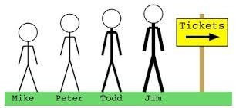
Objectives
Note the need for re-arrangement of a collection of data.
Learn selection sorting technique.
Learn bubble sorting technique.

Slide 3

Sorting
Sorting is the re-arrangement of a collection of data in either ascending or descending order.
It is a common activity in data management.
Input: A sequence of n elements
  a₁, a₂, . . . , a_{n}
Output: A reordered list of n elements
  a₁’, a₂’, . . . , a_{n}’ of the input sequence
  such that a₁’ ≤ a₂’ ≤ · · · ≤ a_{n}’ or a₁’ >= a₂’ >= · · · >= a_{n}’
    Can you recollect where you have encountered sorted
items / lists?

Slide 4


Sorting techniques
Selection sort
Bubble sort
Insertion sort
Merge sort
Quick sort

Slide 5
Selection sort
Selection sort (ascending order) involves
  scanning through the list to find (or select) the smallest element.
  swapping it with the first element.
The rest of the list is then searched for the next smallest and it is swapped with the second element.
This process is repeated until the rest of the list reduces to one element, by which time the list is sorted.
The list is rearranged from smallest to largest.

Slide 6

General strategy
The list is divided into two sub lists: sorted and unsorted
which are divided by an imaginary wall.
We select (find) the smallest element from the unsorted sub list
We swap it with the element at the beginning of the unsorted data.
After each selection and swapping,
  The imaginary wall between the two sub lists move one element ahead.
  Increasing the number of sorted elements and decreasing the number of unsorted ones.
Each time we move one element from the unsorted sub list to the sorted sub list, we say that we have completed a pass.
A list of n elements requires n-1 passes to completely rearrange the data.

Slide 7

General strategy contd---
Repeatedly scan through the list of elements.
Select the smallest element (S in figure below).
Swap the smallest element with the first element ( F in figure below ) in the remaining list of elements.
F | - | - | - | - | - | S
 | F | - | S | - | - | -
 |  | F | - | - | S | -
 |  |  | - | - | - | -
Figure: Select and swap process

Slide 8
Eg: Sort a list of 6 elements from smallest to largest
70
60
50
40
30
20
10
0
A
B
C
D
E
F
[1]
[2]
[3]
[4]
[5]
[6]

Slide 9
Start by finding the smallest entry.
70
60
50
40
30
20
10
0
A
B
C
D
E
F
[1]
[2]
[3]
[4]
[5]
[6]

Slide 10
Swap the smallest entry with the first entry.
70
60
50
40
30
20
10
0
A
B
C
D
E
F
[1]
[2]
[3]
[4]
[5]
[6]

Slide 11
We have swapped the smallest entry with the first entry.
70
60
50
40
30
20
10
0
E
B
C
D
A
F
[1]
[2]
[3]
[4]
[5]
[6]

Slide 12




Part of the array is now sorted…
Sorted side
Unsorted side
70
60
50
40
30
20
10
E
B
C
D
A
F
0
[1]
[2]
[3]
[4]
[5]
[6]

Slide 13















Now, find the smallest entry in the unsorted side.
Sorted side
Unsorted side
70
60
50
40
30
20
10
E
B
C
D
A
F
0
[1]
[[22]]
[[33]]
[[44]]
[[55]]
[6]

Slide 14
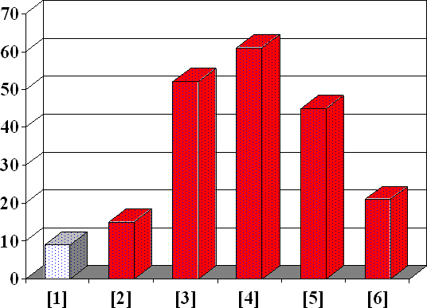
Swap this smallest entry with the front of the unsorted side.
Sorted side Unsorted side
E
F
C
D
A
B

Slide 15

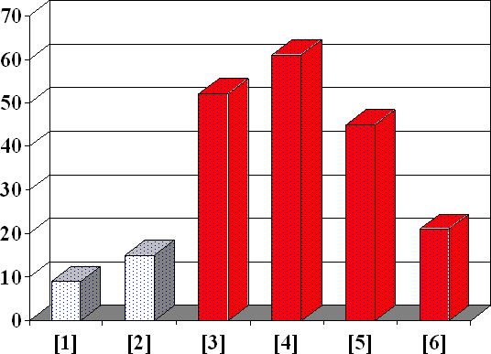
We have increased the size of the sorted side by one
entry.
Sorted side
Unsorted side
E
F
C
D
A
B

Slide 16


The process continues…
Sorted side
Unsorted side
Smallest from unsorted
E
F
C
D
A
B

Slide 17
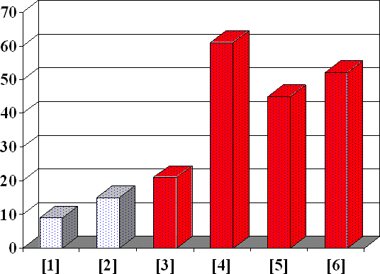



The process continues…
Sorted side
Unsorted side
E
F
B
D
A
C

Slide 18

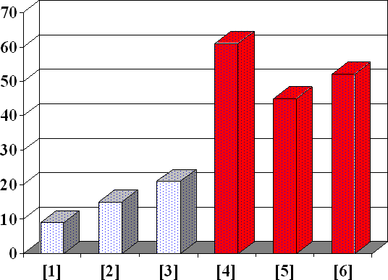
The process continues…
Sorted side
Unsorted side
E
F
B
D
A
C

Slide 19
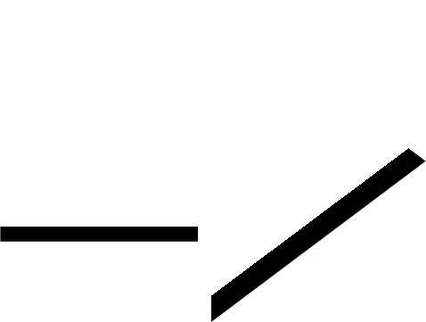


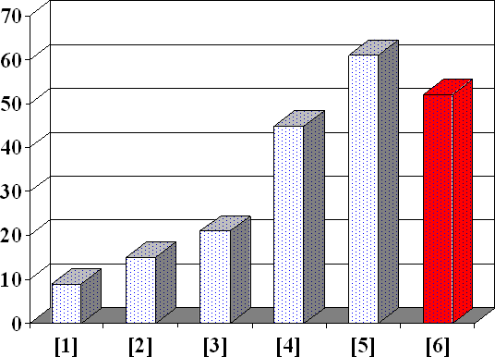
The process keeps adding one more entry to the sorted side.
The sorted side has the smallest entries, arranged from small to large.
Sorted side is bigger
Unsorted
side
Sorted side
E
F
B
A
D
C

Slide 20

We can stop when the unsorted side has just one entry, since that entry must be the largest entry.
Sorted side
Unsorted
side
E
F
B
A
D
C

Slide 21















The list is now sorted…
70
60
50
40
30
20
10
0
E
F
B
A
C
D
[1] [2] [3] [4] [5] [6]
We repeatedly selected the smallest entry, and moved this entry to the front of the unsorted side.

Slide 22
Eg:The scan, select and swap process
8 | 4 | 6 | 9 | 2 | 3 | 1
1 | 2 | 3 | 4 | 9 | 6 | 8
1 | 4 | 6 | 9 | 2 | 3 | 8
1 | 2 | 3 | 4 | 6 | 9 | 8
1 | 2 | 6 | 9 | 4 | 3 | 8
1 | 2 | 3 | 4 | 6 | 8 | 9
1 | 2 | 3 | 9 | 4 | 6 | 8
1 | 2 | 3 | 4 | 6 | 8 | 9

Slide 23

Perform selection sort
Sorted
Unsorted
23 | 78 | 45 | 8 | 32 | 56
Original List
After pass 1
After pass 2
After pass 3
After pass 4
After pass 5

Slide 24
Solution
Sorted
Unsorted
23 | 78 | 45 | 8 | 32 | 56
Original List
After pass 1
After pass 2
After pass 3
After pass 4
After pass 5

Slide 25
Sorted
Unsorted
23 | 78 | 45 | 8 | 32 |  | 56
8 | 78 | 45 | 23 | 32 |  | 56
8 | 23 | 45 | 78 | 32 |  | 56
8 | 23 | 32 | 78 | 45 |  | 56
8 | 23 | 32 | 45 |  | 78 | 56
8 | 23 | 32 | 45 | 56 |  | 78
Original List
After pass 1
After pass 2
After pass 3
After pass 4
After pass 5

Slide 26


Perform selection sort : show the scan, selection and swap process.
Perform sort by selecting the largest element and swapping it.
40 | 2 | 1 | 43 | 3 | 65 | 0 | -1 | 58 | 3 | 42 | 4

Slide 27
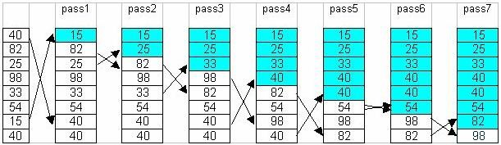
Solution

Slide 28
Selection sort algorithm
n ← length of the list A Repeat from j = 1 to n
let smallest ← j
Repeat from i = j + 1 to n
j
1 2 3
n
i = j+1
if list A[i] < list A[smallest] then smallest ← i
exchange list A[j] ↔ list A[smallest]

Slide 29

Bubble Sort
Idea: Bubble in water.
  Bubble in water moves upward.
  When a bubble moves upward, the water from above will move downward to fill in the space left by the bubble.
General strategy
Repeatedly scan through the list of elements.
Swap adjacent elements that are out of order.
  looks at pairs of entries in the list, and swaps their order if needed.

Slide 30







Bubble Sort
9, 6, 2, 12, 11, 9, 3, 7
6, 9, 2, 12, 11, 9, 3, 7
Bubblesort compares the numbers in pairs from left to right exchanging when necessary. Here the first number is compared to the second and as it is larger they are exchanged.
6, 2, 9, 12, 11, 9, 3, 7
Now the next pair of numbers are compared. Again the 9 is the
larger and so this pair is also exchanged.
In the third comparison, the 9 is not larger than the 12 so no exchange is made. We move on to compare the next pair without any change to the list.
6, 2, 9, 12, 11, 9, 3, 7
6, 2, 9, 11, 12, 9, 3, 7
The 12 is larger than the 11 so they are exchanged.
6, 2, 9, 11, 9, 12, 3, 7
The twelve is greater than the 9 so they are exchanged
The end of the list has been reached so this is the end of the first pass. The twelve at the end of the list must be largest number in the list and so is now in the correct position. We now start a new pass from left to right.
6, 2, 9, 11, 9, 3, 12, 7
The 12 is greater than the 3 so they are exchanged.
6, 2, 9, 11, 9, 3, 7, 12
The 12 is greater than the 7 so they are exchanged.

Slide 31

^{First Pass} 6, 2, 9, 11, 9, 3, 7, 12
Bubble Sort Example
Second Pass
2, 6, 9, 9, 3, 7, 11, 12
6, 2, 9, 11, 9, 3, 7, 12
2, 6, 9, 11, 9, 3, 7, 12
2, 6, 9, 9, 11, 3, 7, 12
2, 6, 9, 9, 3, 11, 7, 12
Notice that this time we do not have to compare the last two numbers as we know the 12 is in position. This pass therefore only requires 6 comparisons.

Slide 32

First Pass _{6,}
Bubble Sort Example
2, | 9, | 11, | 9, | 3, | 7, | 12
6, | 9, | 9, | 3, | 7, | 11, | 12
6, | 9, | 3, | 7, | 9, | 11, | 12
Second Pass
2,
Third Pass
2,
2, 6, 9, 9, 3, 7, 11, 12
2, 6, 9, 3, 9, 7, 11, 12
This time the 11 and 12 are in position. This pass therefore only requires 5 comparisons.

Slide 33
First Pass _{6,}
Bubble Sort Example
2, | 9, | 11, | 9, | 3, | 7, | 12
6, | 9, | 9, | 3, | 7, | 11, | 12
6, | 9, | 3, | 7, | 9, | 11, | 12
6, | 3, | 7, | 9, | 9, | 11, | 12
Second Pass
2,
Third Pass
2,
Fourth Pass
2,
2, 6, 9, 3, 7, 9, 11, 12
2, 6, 3, 9, 7, 9, 11, 12
Each pass requires fewer comparisons. This time only 4 are needed.

Slide 34

^{First Pass} 6, 2, 9, 11, 9, 3, 7, 12
Bubble Sort Example
Second Pass
2, 6, 9, 9, 3, 7, 11, 12
Third Pass
2, 6, 9, 3, 7, 9, 11, 12
2, | 6, | 3, | 7, | 9, | 9, | 11, | 12
2, | 3, | 6, | 7, | 9, | 9, | 11, | 12
Fourth Pass
Fifth Pass
2, 6, 3, 7, 9, 9, 11, 12
The list is now sorted but the algorithm does not know this until it completes a pass with no exchanges.

Slide 35


^{First Pass} 6, 2, 9, 11, 9, 3, 7, 12
Bubble Sort Example
Second Pass
2, 6, 9, 9, 3, 7, 11, 12
Third Pass
2, 6, 9, 3, 7, 9, 11, 12
Fourth Pass
2, 6, 3, 7, 9, 9, 11, 12
Fifth P
This pass no exchanges are made so the algorithm knows the list is sorted. It can therefore save time by not doing the final pass. With other lists this check could save much more work.
ass
2, 3, 6, 7, 9, 9, 11, 12
Sixth Pass
2, 3, 6, 7, 9, 9, 11, 12

Slide 36





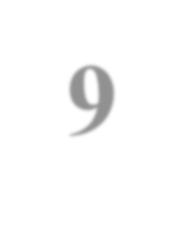







Bubble sort compares the numbers in pairs from
left to right exchanging when necessary.
Eg: Bubble Sort
9, 6, 2, 12, 11, 9, 3, 7
The first number is compared to the second and as it is larger they are exchanged.
6, 9, 2, 12, 11, 9, 3, 7
Now the next pair of numbers are compared. Again the 9 is the larger and so this pair is also exchanged.
6, 2, 9, 12, 11, 9, 3, 7
In the third comparison, the 9 is not larger than the 12 so no exchange is made.
We move on to compare the next pair without any change to the list.

Slide 37


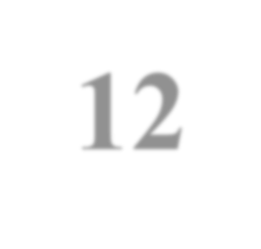




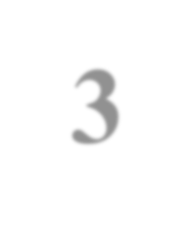


6, 2, 9, 12, 11, 9, 3, 7
Bubble Sort contd---
The 12 is larger than the 11 so they are exchanged.
6, 2, 9, 11, 12, 9, 3, 7
The 12 is greater than the 9 so they are exchanged.
6, 2, 9, 11, 9, 12, 3, 7
The 12 is greater than the 3 so they are exchanged.
6, 2, 9, 11, 9, 3, 12, 7
The 12 is greater than the 7 so they are exchanged.

Slide 38




Bubble Sort contd---
6, 2, 9, 11, 9, 3, 7, 12
The end of the list has been reached so this is the end of the first pass.
The 12 at the end of the list must be largest number in the list and so is now in the correct position.
  We now start a new pass from left to right.

Slide 39


Bubble Sort : Second pass
^{First Pass} 6, 2, 9, 11, 9, 3, 7, 12
Second Pass
2, 6, 9, 9, 3, 7, 11, 12
6, 2, 9, 11, 9, 3, 7, 12
2, 6, 9, 11, 9, 3, 7, 12
2, 6, 9, 9, 11, 3, 7, 12
2, 6, 9, 9, 3, 11, 7, 12
Notice that this time we do not have to compare the last two
numbers as we know the 12 is in position.
This pass therefore only requires 6 comparisons.

Slide 40


^{First Pass} 6, 2, 9, 11, 9, 3, 7, 12
Bubble Sort : Third pass
Second Pass
2, 6, 9, 9, 3, 7, 11, 12
Third Pass
2, 6, 9, 3, 7, 9, 11, 12
2, 6, 9, 9, 3, 7, 11, 12
2, 6, 9, 3, 9, 7, 11, 12
This time the 11 and 12 are in position.
This pass therefore only requires 5 comparisons.

Slide 41


Bubble Sort : Fourth pass
^{First Pass} 6, 2, 9, 11, 9, 3, 7, 12
Second Pass
Third Pass Fourth Pass
2, | 6, | 9, | 9, | 3, | 7, | 11, | 12
2, 6, 9, 3, 7, 9, 11, 12
2, | 6, | 3, | 7, | 9, | 9, | 11, | 12
2, 6, 9, 3, 7, 9, 11, 12
2, 6, 3, 9, 7, 9, 11, 12
Each pass requires fewer comparisons.
This time only 4 are needed.

Slide 42


Bubble Sort : Fifth pass
^{First Pass} 6, 2, 9, 11, 9, 3, 7, 12
Second Pass
Third Pass
Fourth Pass
Fifth Pass
2, | 6, | 9, | 9, | 3, | 7, | 11, | 12
2, 6, 9, 3, 7, 9, 11, 12
2, | 6, | 3, | 7, | 9, | 9, | 11, | 12
2, | 3, | 6, | 7, | 9, | 9, | 11, | 12
The list is now sorted but the algorithm does not know this until it
completes a pass with no exchanges.

Slide 43


Bubble Sort : Sixth pass
Fifth Pass
2, 3, 6, 7, 9, 9, 11, 12
Sixth Pass
2, 3, 6, 7, 9, 9, 11, 12
This pass no exchanges are made so the algorithm knows the list is sorted.
It can therefore save time by not doing the final pass. With other lists
this check could save much more work.

Slide 44

Perform bubble sort : show the scan and swap.
List #1
List #2

Slide 45
Solution

Slide 46

Pass 1
http://www.powershow.com/view/158a13- ZjNmN/ICS103_Programming_in_C_Lecture_14_Searching_and_Sorting_powerpoint_ppt_presentation

Slide 47

Pass 2

Slide 48


Pass 3

Slide 49

Pass 4

Slide 50
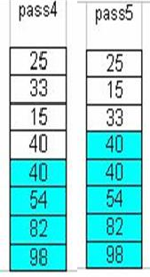
Pass 5

Slide 51
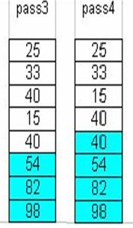


Pass 6

Slide 52
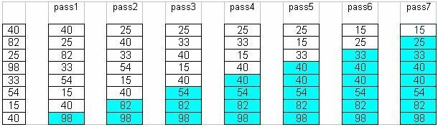
Pass 7

Slide 53
Solution
1
2
40 | 2 | 1 | 43 | 3 | 65 | 0 | -1 | 58 | 3 | 42 | 4
2 | 1 | 40 | 3 | 43 | 0 | -1 | 58 | 3 | 42 | 4 | 65
3
4
1 | 2 | 3 | 40 | 0 | -1 | 43 | 3 | 42 | 4 | 58 | 65
1 | 2 | 3 | 0 | -1 | 40 | 3 | 42 | 4 | 43 | 58 | 65

Slide 54
Solution contd ---
5
1 | 2 | 0 | -1 | 3 | 3 | 40 | 4 | 42 | 43 | 58 | 65
6
1 | 0 | -1 | 2 | 3 | 3 | 4 | 40 | 42 | 43 | 58 | 65
7
8
0 | -1 | 1 | 2 | 3 | 3 | 4 | 40 | 42 | 43 | 58 | 65
-1 | 0 | 1 | 2 | 3 | 3 | 4 | 40 | 42 | 43 | 58 | 65

Slide 55
Bubble sort algorithm
i
1 2 3
n ← length of list A Repeat from i = 1 to n
Repeat from j = i + 1 to n
if list A[j] < list A[j -1]
then exchange A[j] ↔ A[j-1]
n
j

Slide 56

Case study time …..
56

Slide 57

SORTING
How do you sort when you can only compare two things?

Slide 58
Sort
Part One:
  –Find the lightest bottle using the scale
  –What is the easiest way to do this?
Part Two:
  –Choose three bottles at random
  –Sort them using the scale
  –What is the fewest number of comparisons you can do?

Slide 59
Sort
Part Three:
  –Sort all the bottles from lightest to heaviest by repeatedly finding the lightest bottle remaining, and moving it into the sorted list at the top
  –This is known as Selection Sort

Slide 60
Finding the Smallest Item
given: a list of data to find the minimum in
set currentSmallestItem to first item in list while we haven’t looked at all items in list:
set compareItem to next item in list
if compareItem < currentSmallestItem:
save compareItem to currentSmallestItem

Slide 61
Selection Sort
given: a list of data to sort set listSorted to an empty list
set listRemaining to the original list to be sorted while listRemaining is not empty:
set smallestValue to the min value in listRemaining add smallestValue to the end of listSorted
remove smallestValue from listRemaining

Slide 62
Insertion Sort
Take the leftmost bottle from the bottom
Insert it into the correct location in the sorted list
–Do this by comparing the new item with each of the existing items (usually starting at the end) until the correct place is found
This is known as Insertion Sort

Slide 63
Insertion Sort
given: a list of data to sort set listSorted to an empty list
set listRemaining to the original list to be sorted while listRemaining is not empty:
set nextValueToSort to the first item in listRemaining add nextValueToSort to the end of listSorted
while (nextValueToSort) <= (value to its left):
swap nextValueToSort with its neighbour to the left

Slide 64


What has been described?
The need for re-arrangement of a collection of data.
Selection sorting technique.
Bubble sorting technique.
Credits
112.196.5.130/edusat/engg/CompEngg/.../EDUSAT%20Lect.ppt
Analysis of Algorithms, CS 477/677, George Bebis
http://www.powershow.com/view/158a13-
ZjNmN/ICS103_Programming_in_C_Lecture_14_Searching_and_Sorting_powerpoint_ppt_presentation
https://www.coursehero.com/file/6355834/sorting/
CENG 213 Data Structures, METU, CSE
ww.cs.bu.edu/fac/gkollios/cs113/Slides/SortingI.ppt
Google images

